Slide 1
SMART AGRICULTURE
a

Slide 2
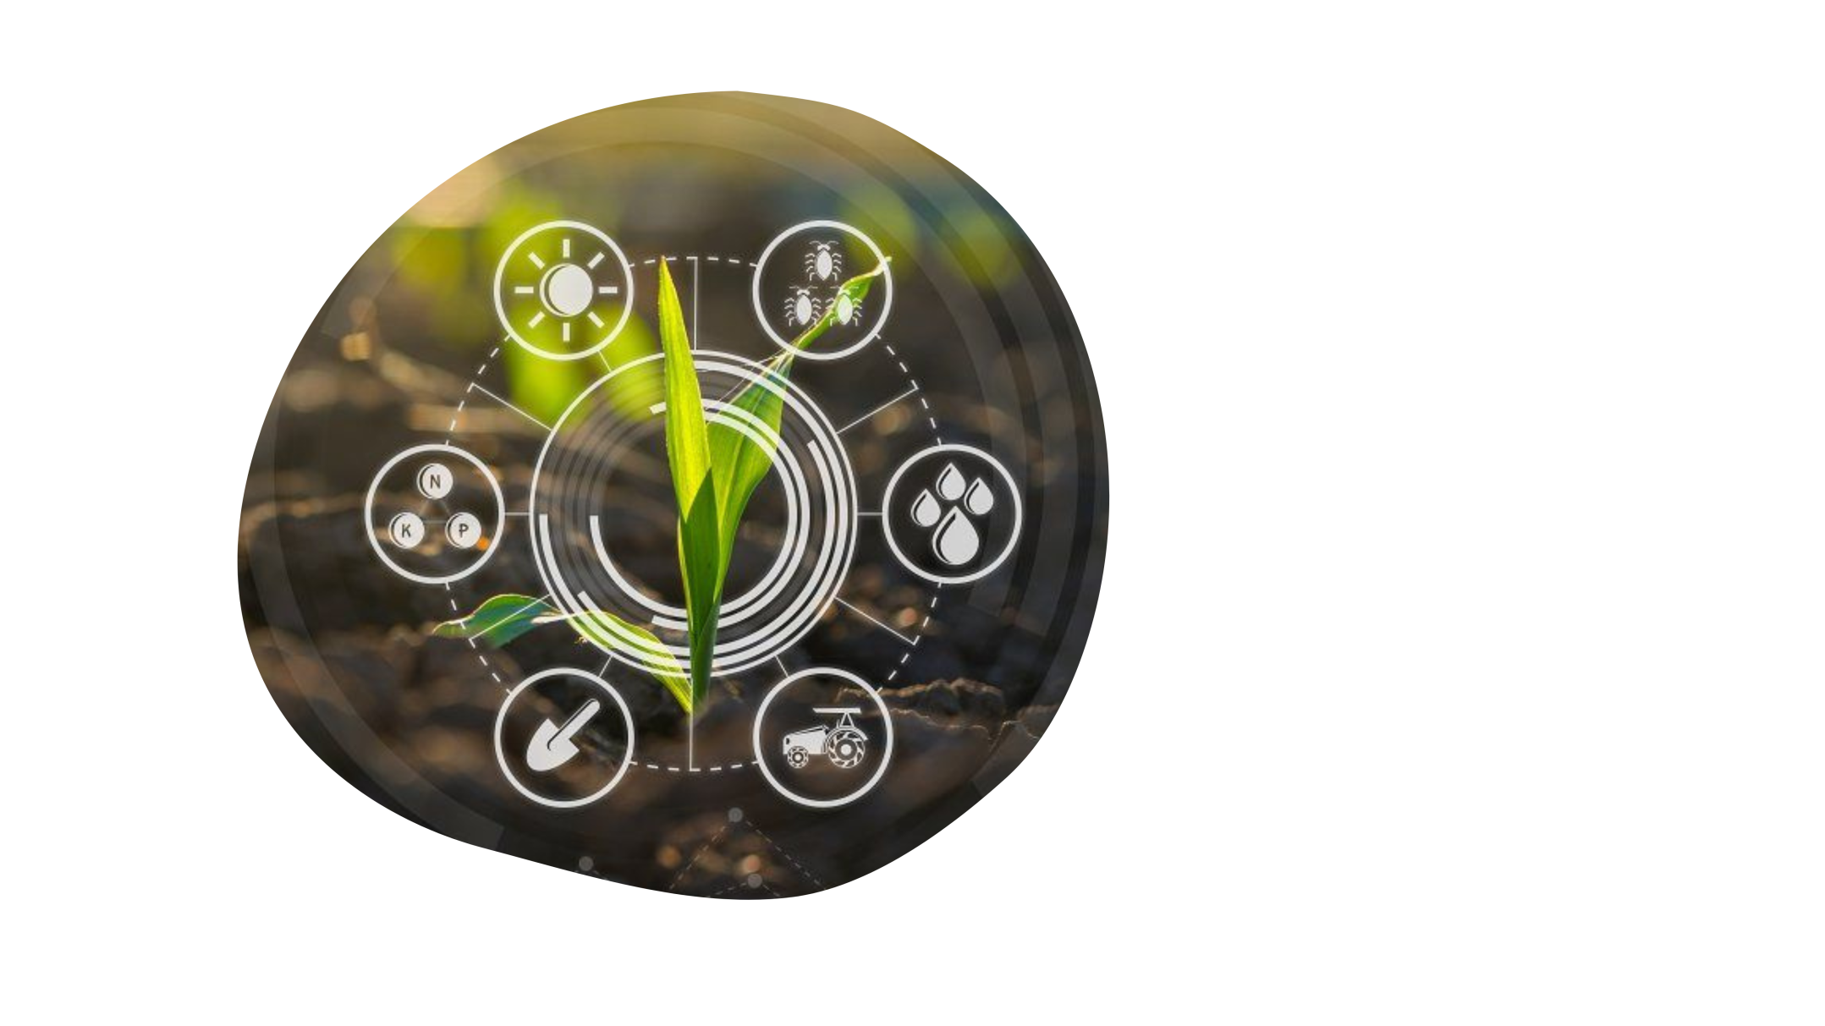
agenda
- Introduction
- Main idea
- AI
- IOT
- Flutter
Cloud computing -

Slide 3
Introduction
Smart Agriculture combines modern science and technology with agricultural cultivation, to achieve unmanned, automatic, intelligent management of agricultural production, such as intelligent fertilization.
It is the application of artificial intelligence (AI) and Internet of Things (IOTs) in the field of modern agriculture.
“SMART AGRICULTURE “ is the project of various information technologies and their cross-application in the field of agriculture, including intelligent equipment, IOTs, intelligent perception, deep learning, machine learning, etc.

Slide 4
Main Idea
The app “Smart agriculture” uses AI to help farmers to detect plant diseases .
and to make prediction to choose the best plant
to be cultivated.
Also generates ideas that help maintain and preserve the environment and decrease dependence on chemical pesticides.
Using IOT to monitor soil PH ,soil moisture, soil salinity, air temperature, air humidity.
Management system viewing agriculture news, time of harvest and weather broadcasting news.

Slide 5
Artificial Intelligence
DATASETS
MODELS
ACCURACY
IMPROVEMENT
TESTING

Slide 6
datasets
Different shapes of different plants and different disease
One shape of plant and different diseases
Different shapes of different plants and group of diseases
Different shapes of one plant and different diseases
One shape of different plants and different diseases

Slide 7
WE FIND ONE
One shape -> different plants -> different disease
DISEASE
PLANT
(Blueberry ( Healthy
(Apple ( Scab
( ( Black rot
( ( Cedar apple rust
( Healthy)
Cherry ( Powdery mildew)
( Healthy)
(Peach ( Bacterial_spot
( ( Healthy
Pepper ( Bell bacterial spot)
( ( Bell healthy
(Potato ( Early blight
( ( Late_blight
( ( Healthy
Blueberry
Cherry
Corn
Orange
Peach
Pepper
Potato
Raspberry
Soybean
Strawberry
Tomato
Grape
APPLE

Slide 8
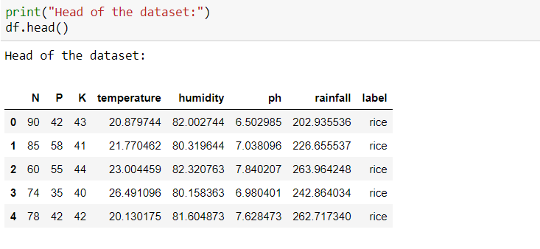
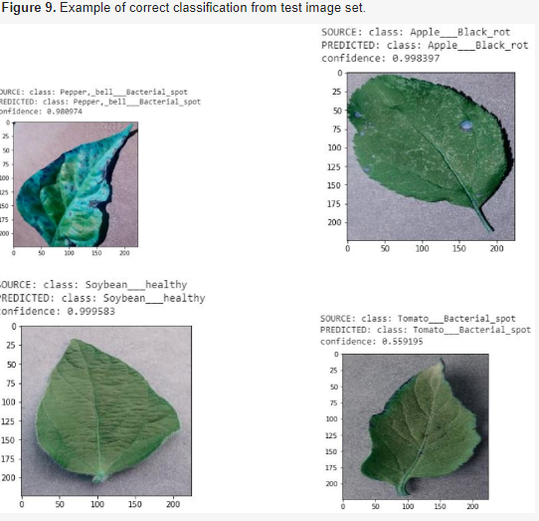
models
prediction
Detection
Using logistic Regression Model
Using CNN

Slide 9
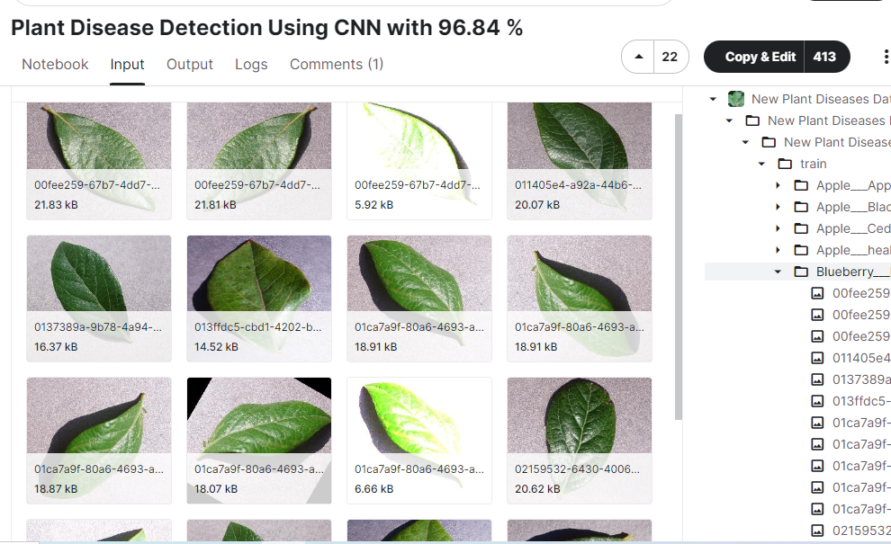
Accuracy

Slide 10
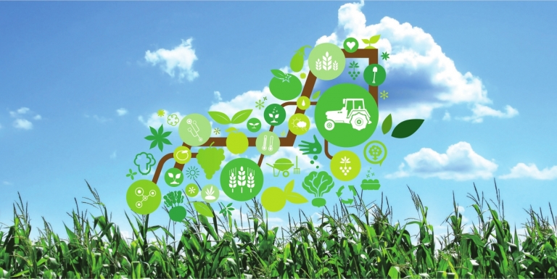
IMPROVEMENT and TESTING
MORE DATA
Detect Accuracy
Detect Plots

Slide 11
Finally
We have model with high accuracy ready for the project ^_^

Slide 12
Smart Agriculture System
IOT presentation

Slide 13
Sensors in our system
NPK Sensor
Rain Sensor
Soil Moisture Sensor
MQ Gas Sensor
Soil Temperature Sensor

Slide 14
NPK sensor
measure the soil’s current N, P, and K levels to determine how much additional nutrient content must be added to increase crop fertility.
Nitrogen ➔ responsible for the growth and greenness of plant leaves
Phosphorus ➔ helps the plant grow strong roots, fruit, and flowers.
Potassium ➔ improves the overall health and hardiness of a plant.
It can therefore be used with any type of soil
It should be noted that the sensor cannot be used with an arduino directly. you’ll need an RS-485 transceiver module that converts a UART serial stream to RS-485
The sensor includes a stainless steel probe that is rust-proof

Slide 15
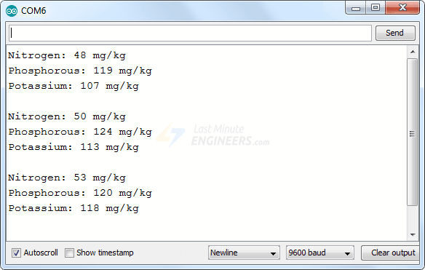
NPK sensor
NPK Sensor Output

Slide 16
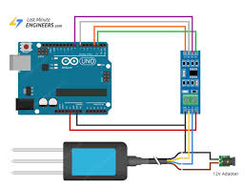
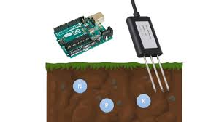
NPK sensor

Slide 17
Rain sensor
You can use this sensor to monitor rain or slushy snow/hail.
The sensing pad with series of exposed copper traces, together acts as a variable resistor.
resistance varies according to the amount of water on it
Resistance is inversely proportional to the amount of water:
The more water will result in a lower resistance.
The less water will result in a higher resistance.

Slide 18
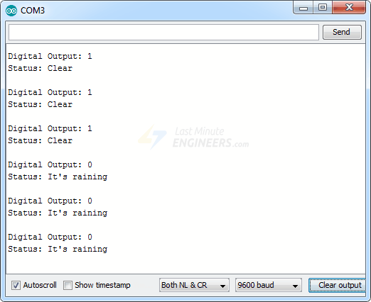
Rain sensor
Output :

Slide 19
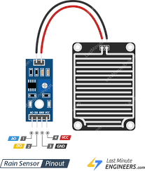
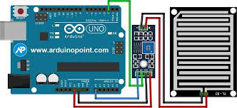
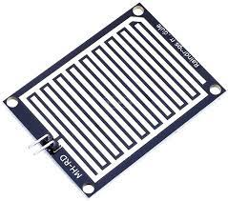
Rain sensor

Slide 20
Soil Moisture sensor
Monitors the moisture level of the soil and automatically supplies the necessary amount of water to the plants.
plants can be watered only when required, avoiding over- or under-watering. (No Wastage)
he fork-shaped probe with two exposed conductors acts as a variable resistor (similar to a potentiometer) whose resistance varies with the soil’s moisture content.
The more water in the soil, the better the conductivity and the lower the resistance.
The less water in the soil, the lower the conductivity and thus the higher the resistance

Slide 21
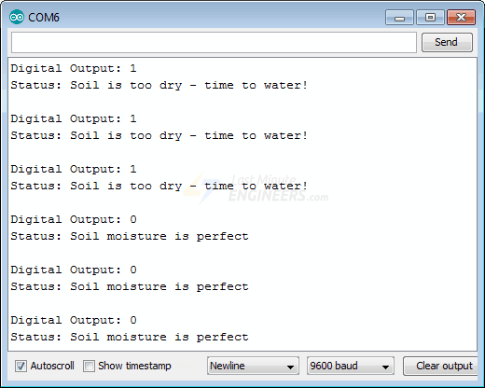
Soil Moisture sensor
Output :

Slide 22
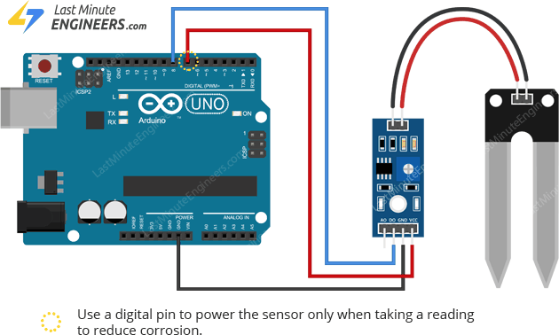
Soil Moisture sensor
Soil Moisture sensor with Arduino :

Slide 23
MQ Gas sensor
detect LPG, Smoke, Alcohol, Propane, Hydrogen, Methane and Carbon Monoxide concentrations ranging from 200 to 10000 ppm.(Parts-per-million)
The higher the concentration, the higher the output voltage
the lower the concentration, the lower the output voltage
The animation below shows the relationship between gas concentration and output voltage.

Slide 24
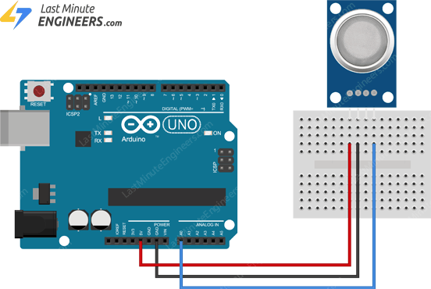
MQ Gas sensor
Gas sensor with Arduino:

Slide 25
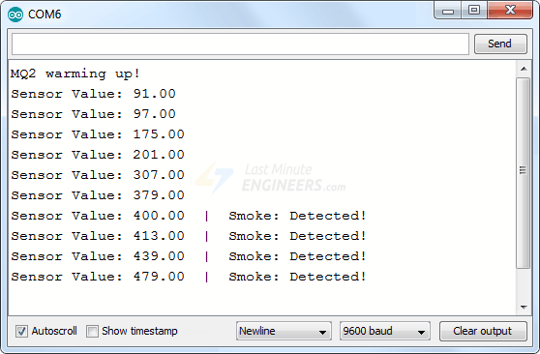
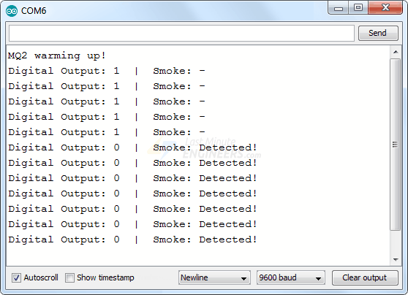
MQ Gas sensor
Analog Output
Digital Output

Slide 26
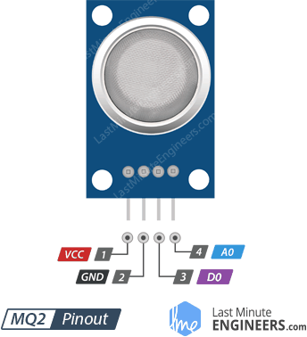
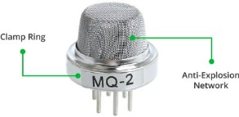
MQ Gas sensor
Pinout
Body

Slide 27
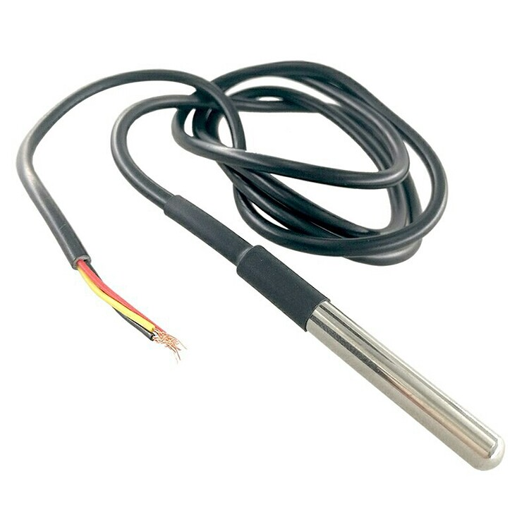
Soil Temperature sensor
A soil temperature sensor is a device used to measure the temperature of the soil.
It is commonly used in applications such as agriculture, gardening, and environmental monitoring to monitor soil temperature for plant growth, irrigation control, and research purposes.

Slide 28
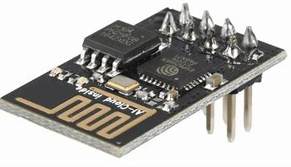
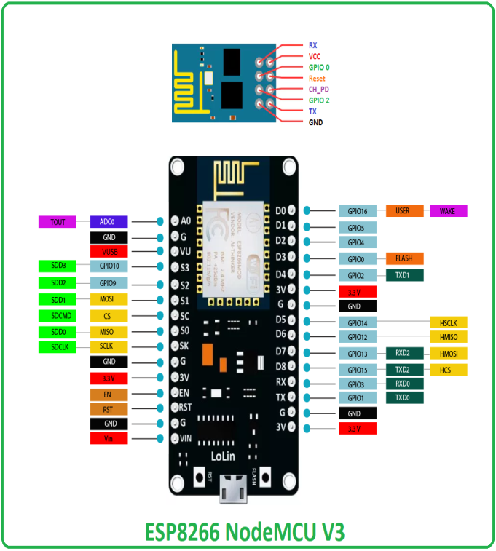
ESP8266 WIFI Module
The ESP8266 is a popular Wi-Fi module that can be used with Arduino boards to enable wireless connectivity
It features a built-in TCP/IP stack, which makes it capable of connecting to Wi-Fi networks and communicating with other devices over the internet.
The ESP8266 can be programmed using the Arduino IDE, making it easy to integrate into Arduino projects.

Slide 29
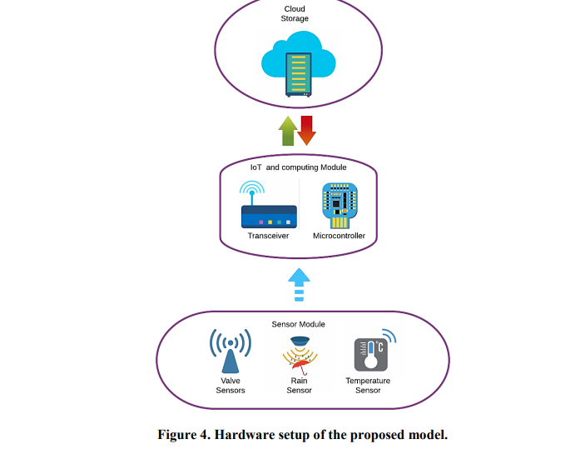
IOT with Cloud

Slide 30
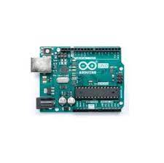


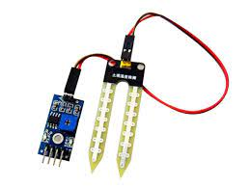
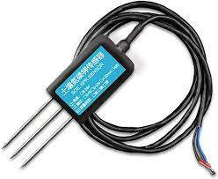
Tools used in IOT part

Slide 31
Conclusion
Finally we will combine those sensors together by using Arduino and WIFI chip to make an IOT device connected to a cloud to store the data from this IOT device .
This data will be used as input of ML model to take action and make a good prediction according to the condition of the soil and the weather.
This prediction will help the farmer to monitor the soil and do the best result .

Slide 32
The End
Thank You

